Slide 1


Pandas
Digital Career Program
Data Analytics II
Part 3.2
Data Merging

Slide 2
Outlines
Introduction
Data Selection
Data Manipulation
Data Aggregation
Data Merging
Data Cleaning
Data Reshaping

Slide 3
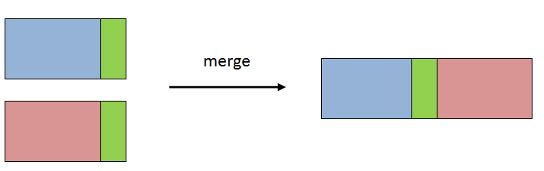
Data Merging
Concat
Vertically
Horizontally
Merge
Inner
Left
Right
Outer
concat

Slide 4
Concat
Concatenate pandas DataFrames along a particular axis
df1
pd.concat ([df1, df2], axis=0)
df2
df1
pd.concat ([df1, df2], axis=1)
df2

Slide 5
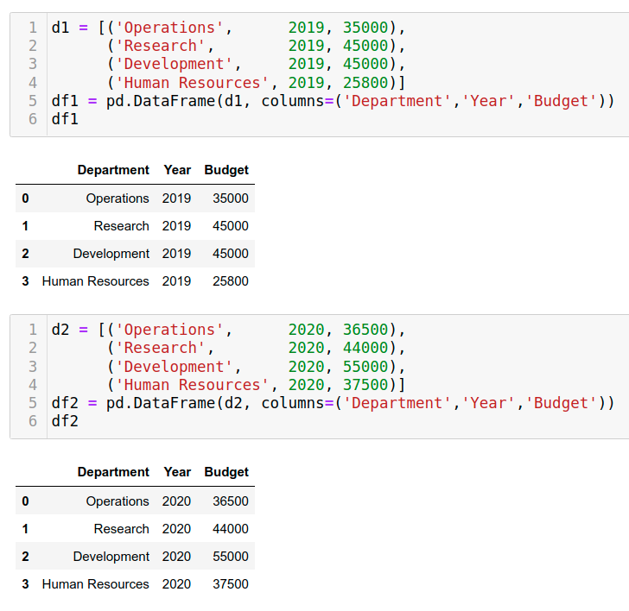
Concat - vertical (axis=0)

Slide 6
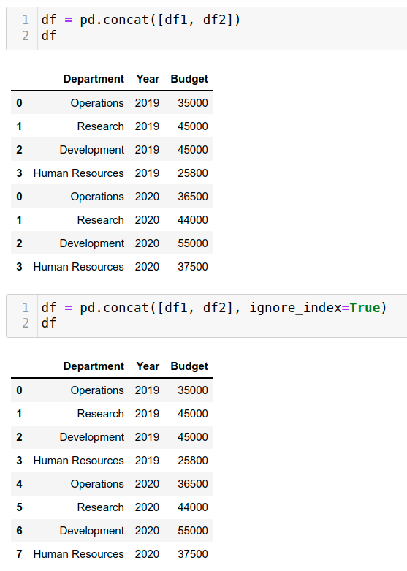
Concat - vertical (axis=0)

Slide 7
Concat - vertical (axis=0)

Slide 8
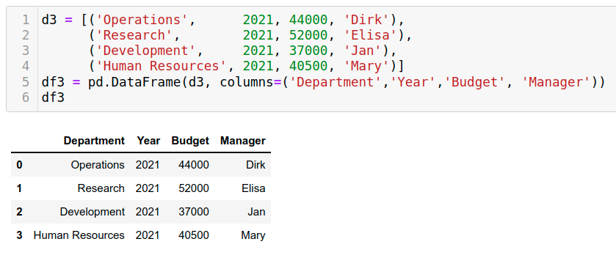
Concat - vertical (axis=0)

Slide 9
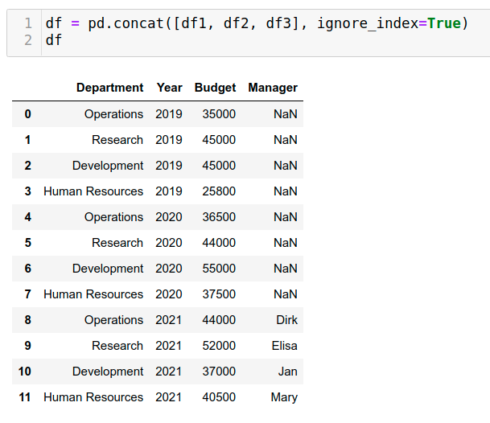
Concat - vertical (axis=0)
?

Slide 10
Concat - vertical (axis=0)

Slide 11
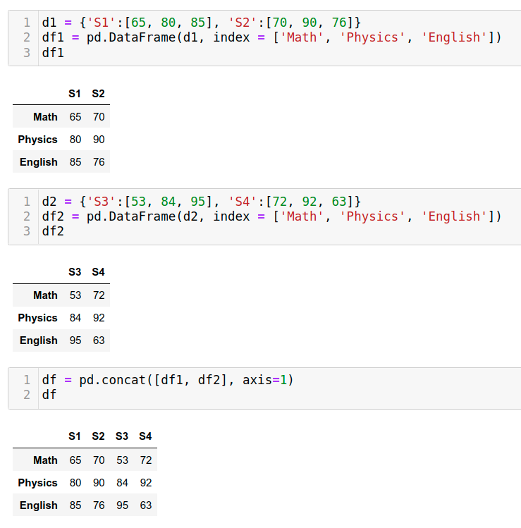
Concat - horizontal (axis=1)

Slide 12
Concat - horizontal (axis=1)

Slide 13
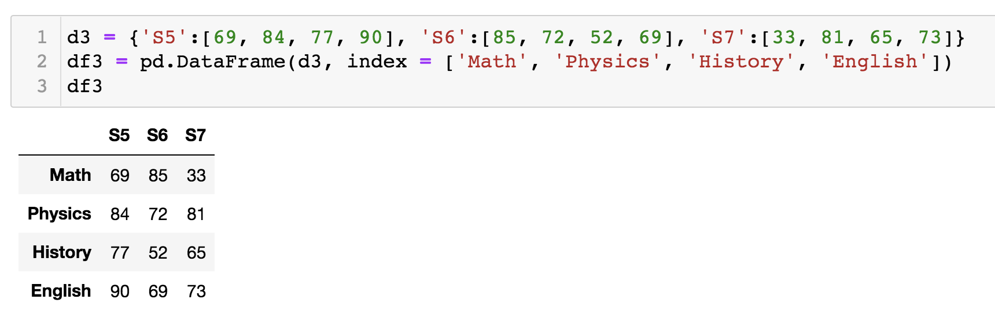
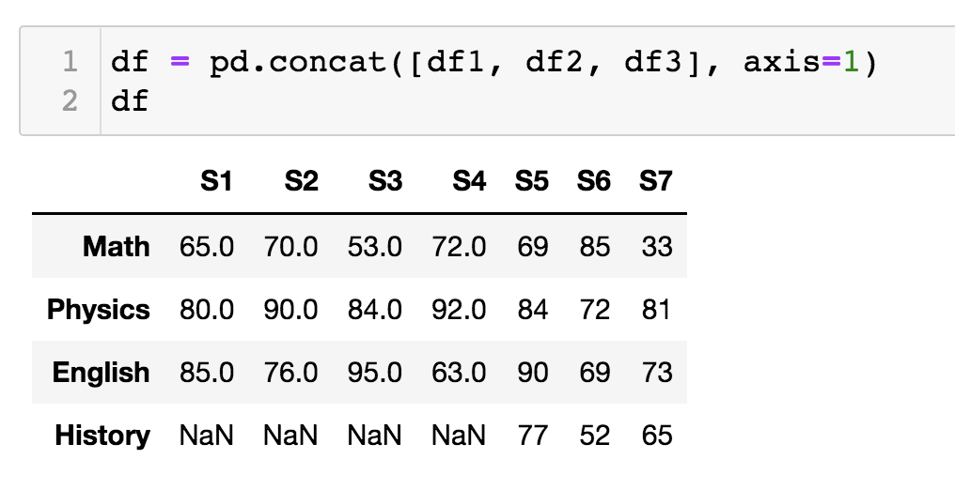
Concat - horizontal (axis=1)
?

Slide 14
Concat - horizontal (axis=1)

Slide 15
Merge
An operation that combines two dataframes into a new dataframe, by matching one or more columns (aka. keys) from both input dataframes.
Each row in the new dataframe is a combination of two rows: one from each input dataframes.
df_merged = df_left.merge (df_right, on="key_column", how="inner")
df_left
df_right
df_merged

Slide 16
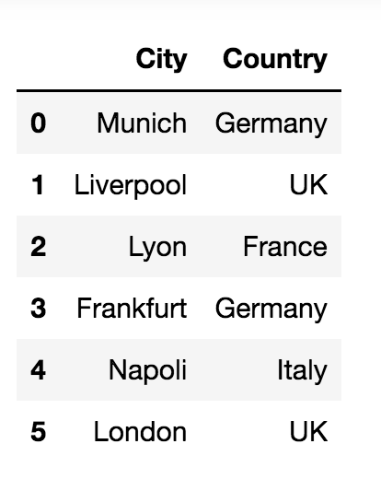
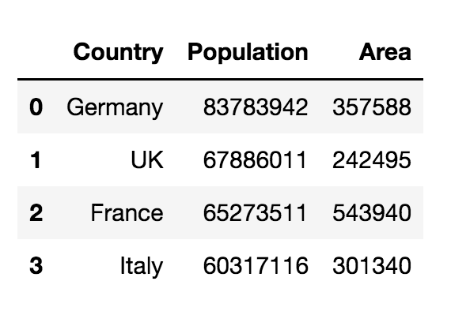
Merge

Slide 17
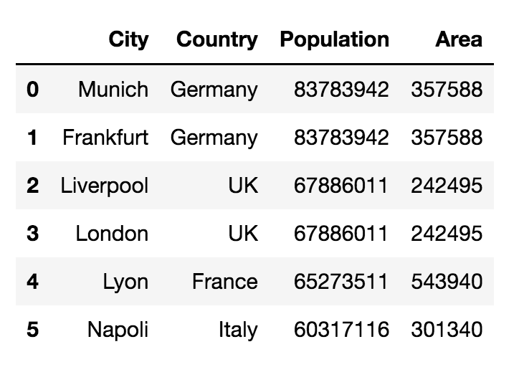
Merge
df_result = df_1.merge(df_2, on="Country")
df_result = pd.merge(df_1, df_2, on="Country")

Slide 18
Merge

Slide 19
Merge

Slide 20
Merge

Slide 21
Merge

Slide 22
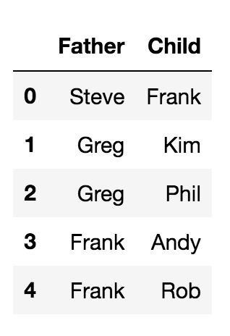
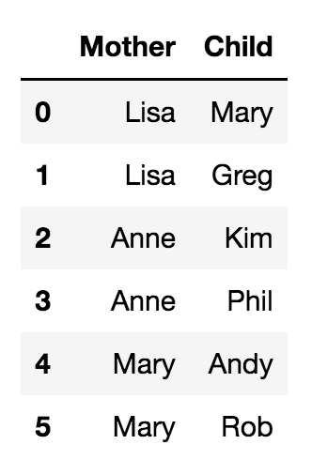
Merge
In the previous example, we have complete match between the two dataframes:
Both dataframes have the same set of countries..
But, what happens when there is no complete match ?!
We want to merge these dataframes to know the fathers and mothers of children..
There are some common children in both tables
But also there are non-matching children!
What happens to them?!
?

Slide 23
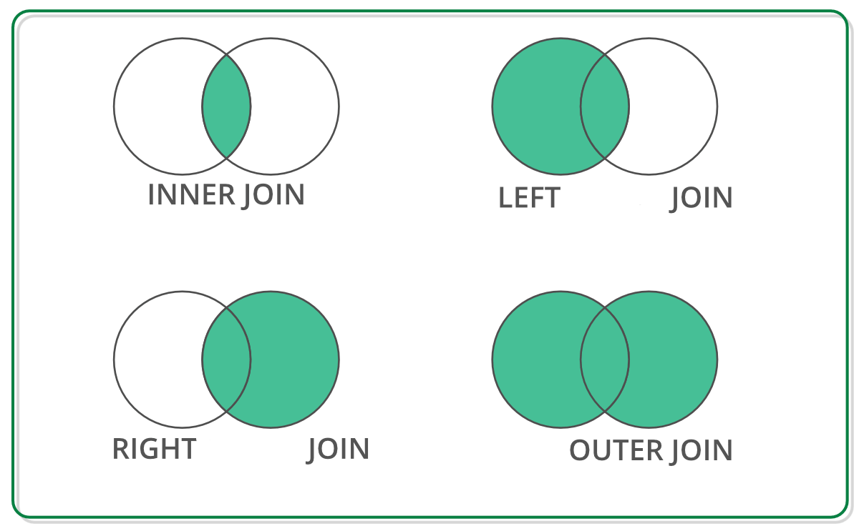
Merge
There are four types of merge:
inner: take only matching rows from both tables
left: take matching rows from both plus non-matching from left table
right: take matching rows from both plus non-matching from right table
outer: take matching rows plus non-matching from both table
inner
left
right
outer

Slide 24
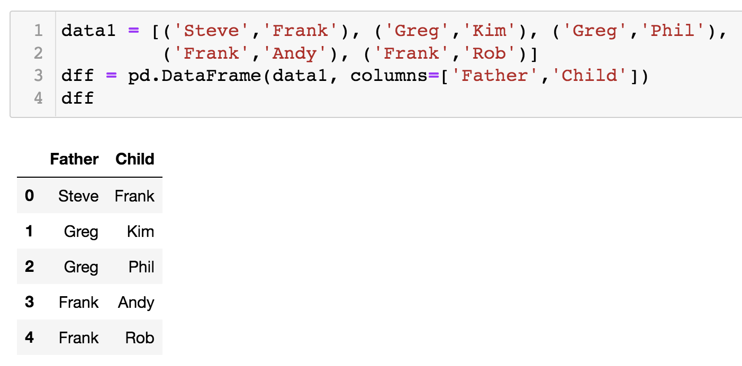
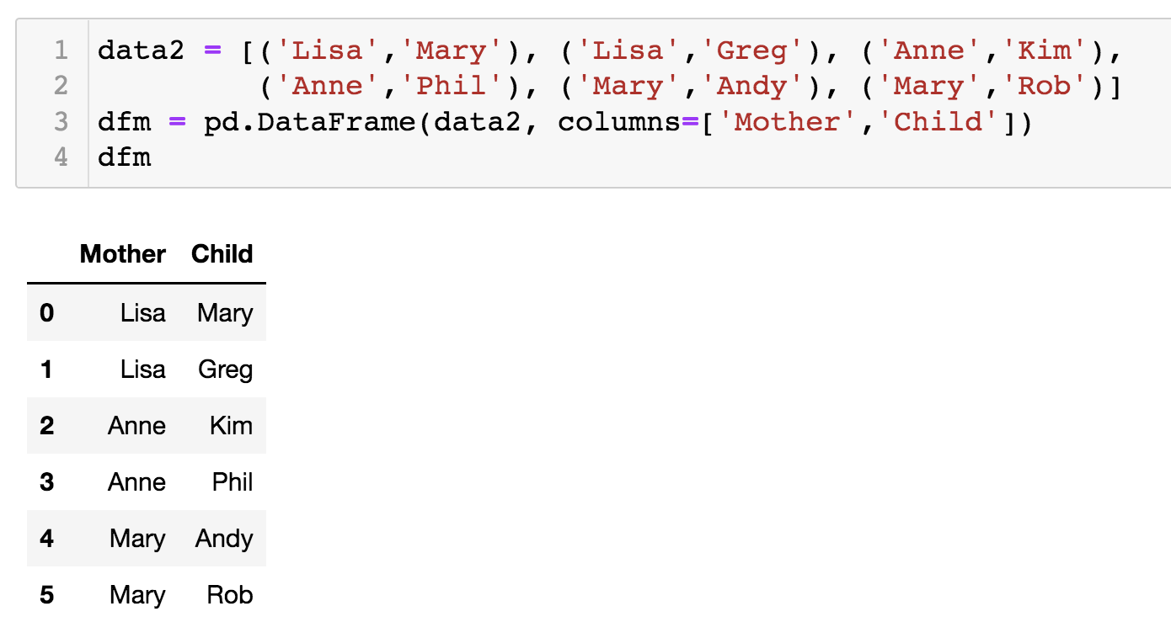
Merge

Slide 25
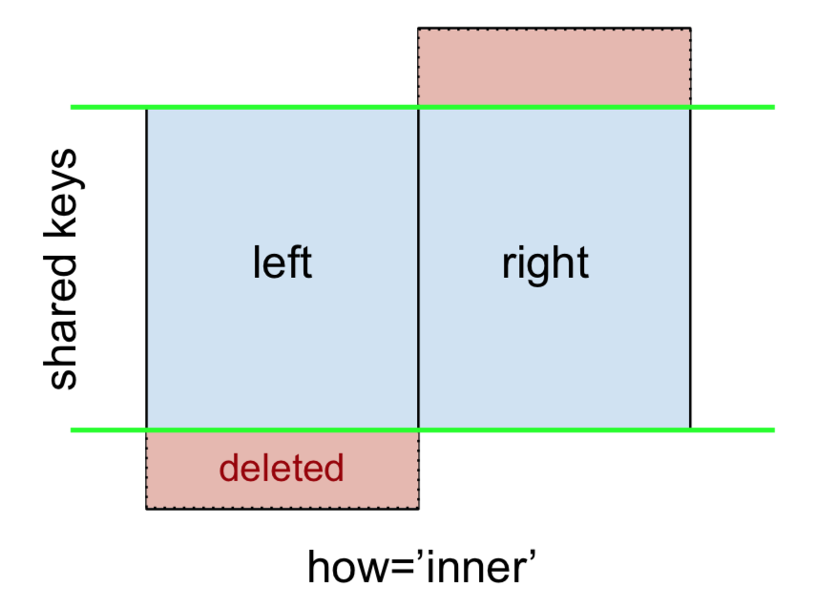
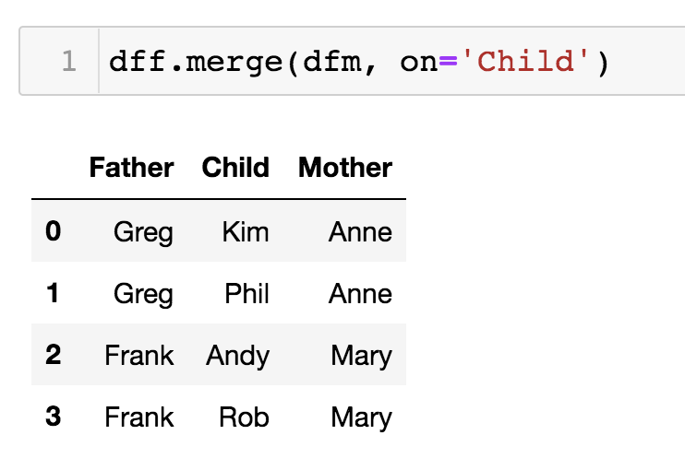
Merge - how='inner'
Only matching rows from both tables are included
Non-matching rows are excluded

Slide 26
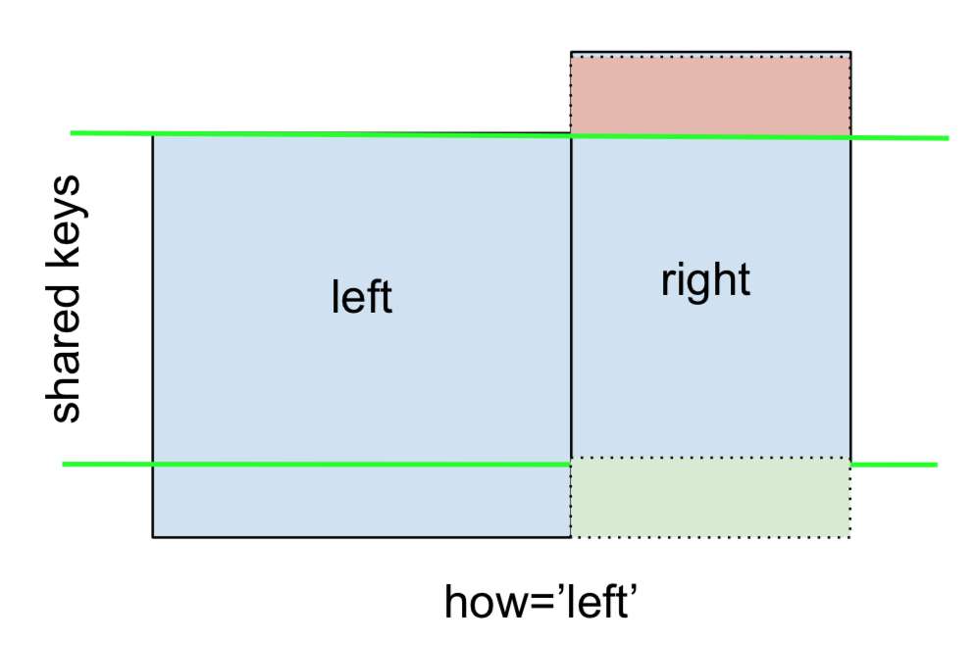
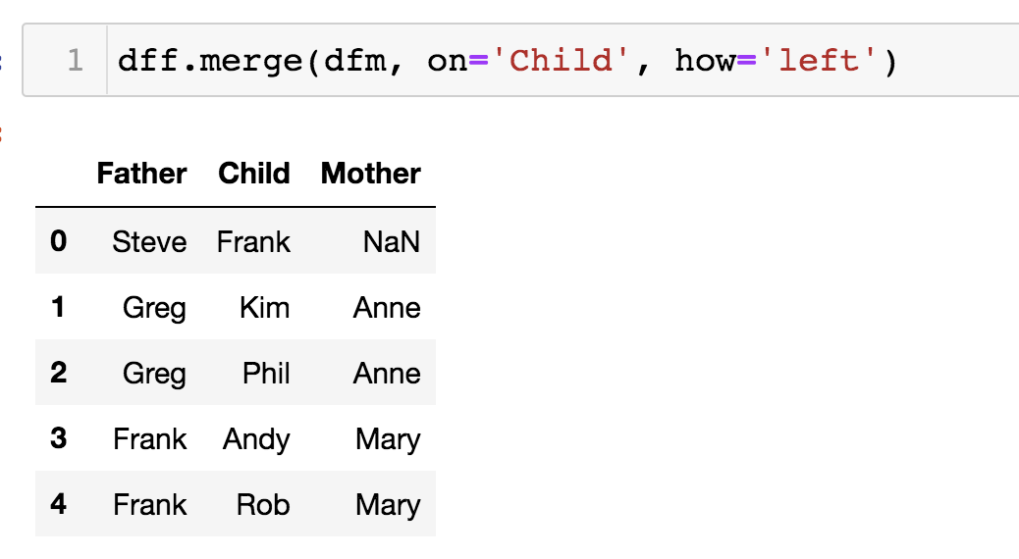
Merge - how='left'
Matching rows from both tables are included
Non-matching rows from left table are included
Non-matching rows from right table are excluded

Slide 27
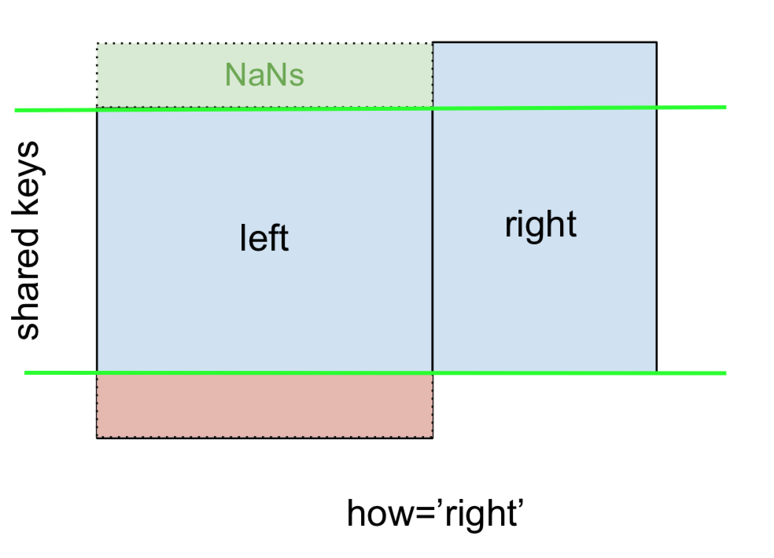
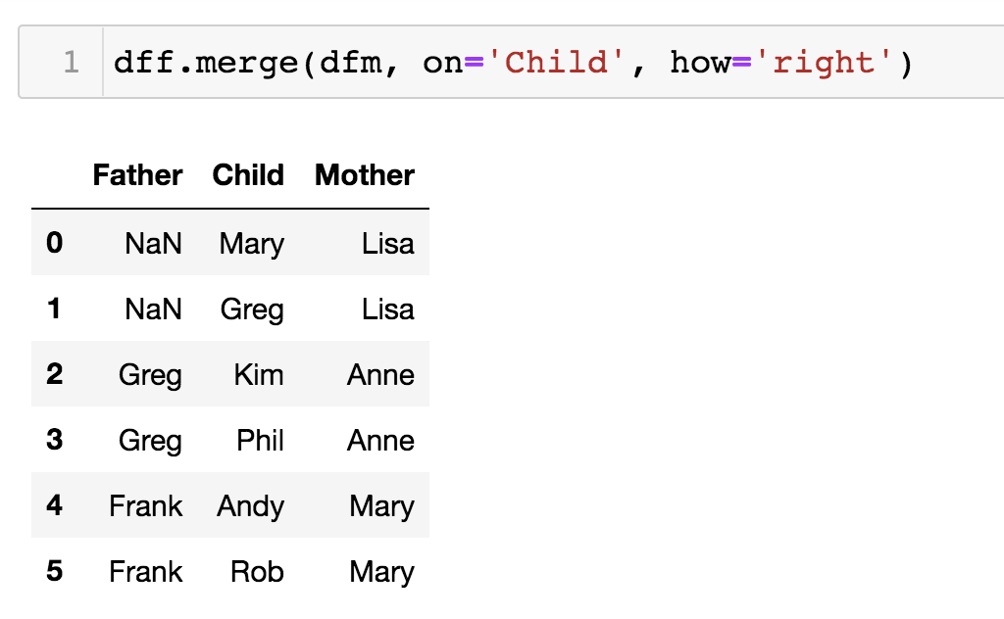
Merge - how='right'
Matching rows from both tables are included
Non-matching rows from left table are excluded
Non-matching rows from right table are included

Slide 28
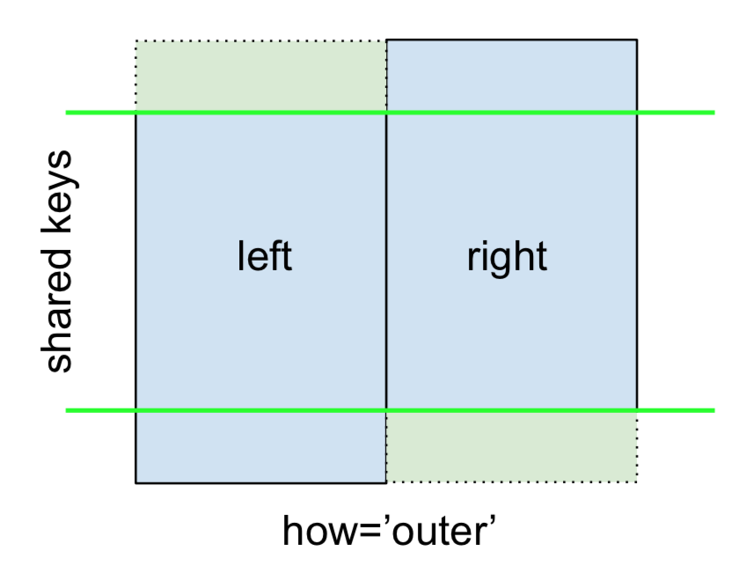
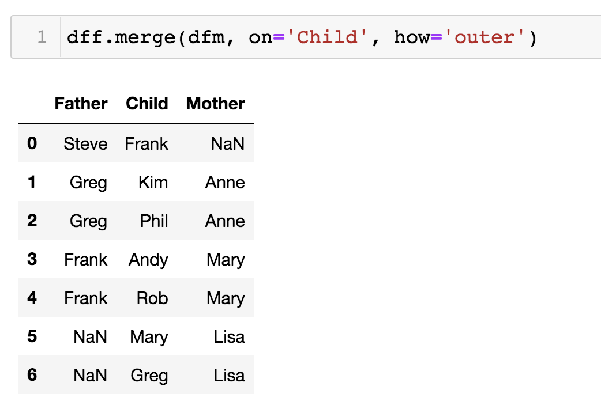
Merge - how='outer'
Matching rows from both tables are included
Non-matching rows from left table are included
Non-matching rows from right table are included

Slide 29
Merge

Slide 30
Merge
inner join
only matching rows will be retained,
rows in the left DataFrame without a match in the key column of the right DataFrame will be discarded.
rows in the right DataFrame without a match in the key column of the left DataFrame will be discarded.
left join
all rows from the left DataFrame will be retained,
rows in the right DataFrame without a match in the key column of the left DataFrame will be discarded.
right join
all rows from the right DataFrame will be retained,
rows in the left DataFrame without a match in the key column of the right DataFrame will be discarded.
outer join
all rows, matching and non-matching, from both DataFrame will be retained,

Slide 31
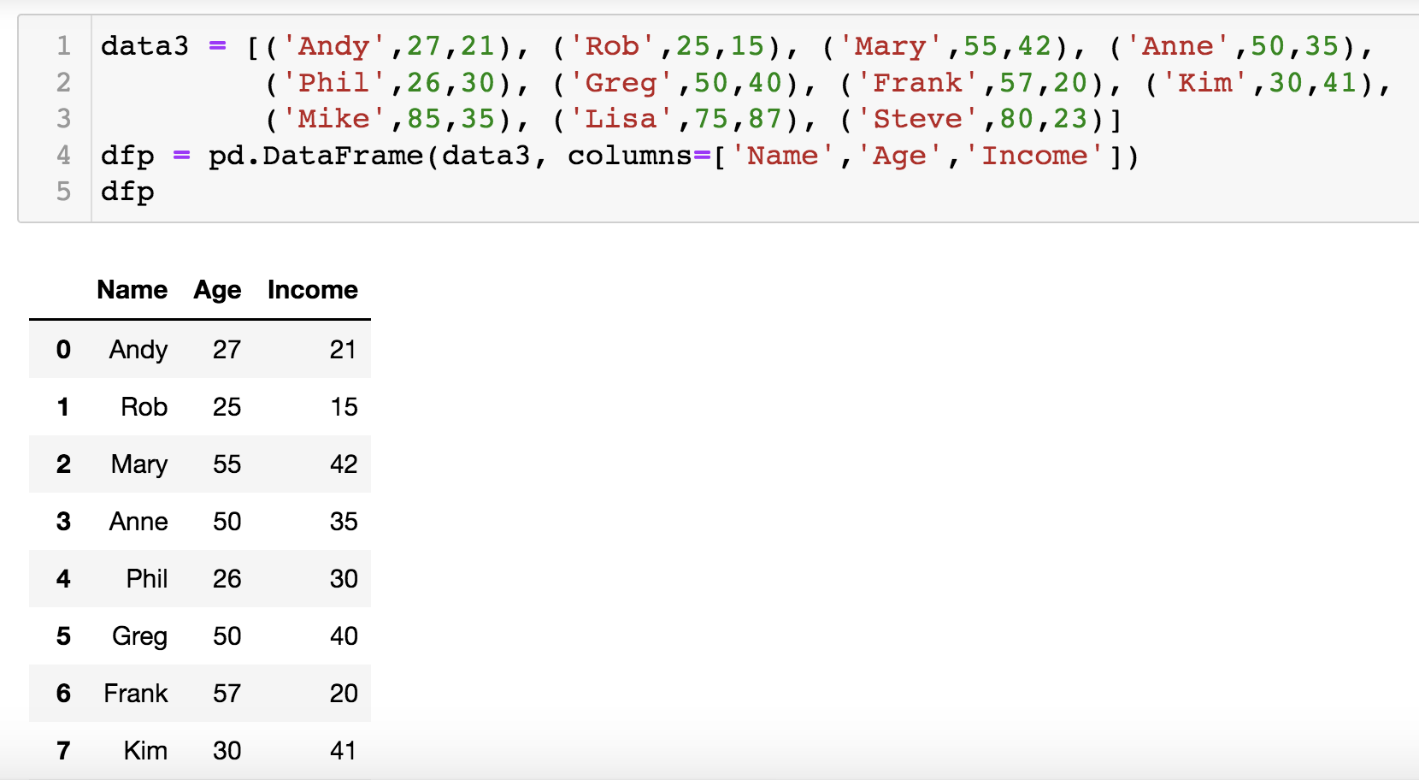
Merge
In previous examples, we merged tables using columns with the same name (Country, Child).
We can also merge tables using columns of different names

Slide 32
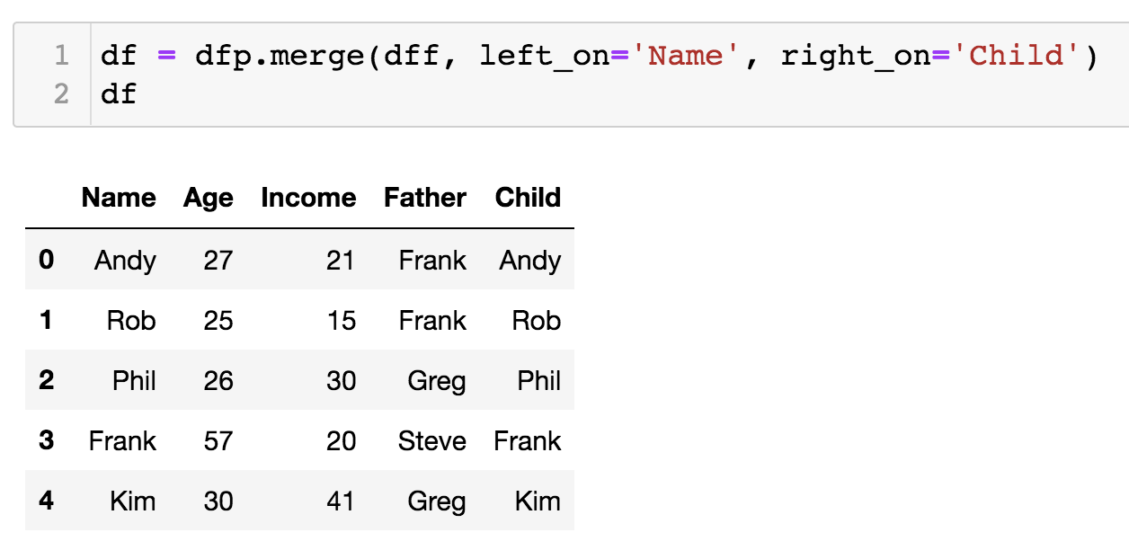
Merge
In previous examples, we merged tables using columns with the same name (Country, Child).
We can also merge tables using columns of different names

Slide 33
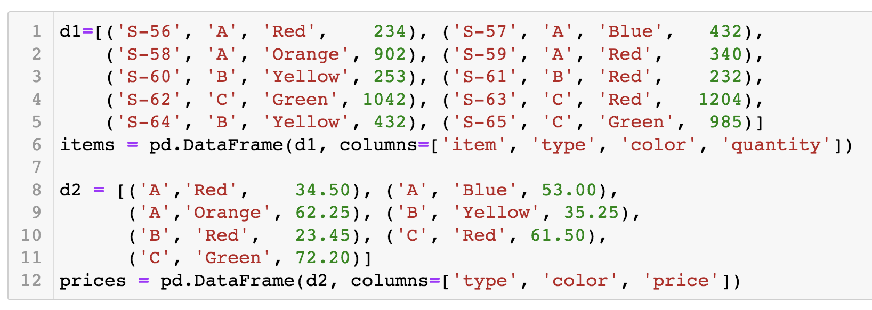
Merge
In previous examples, we merged tables using one column (one key)
We can also merge tables using multiple columns (keys)

Slide 34
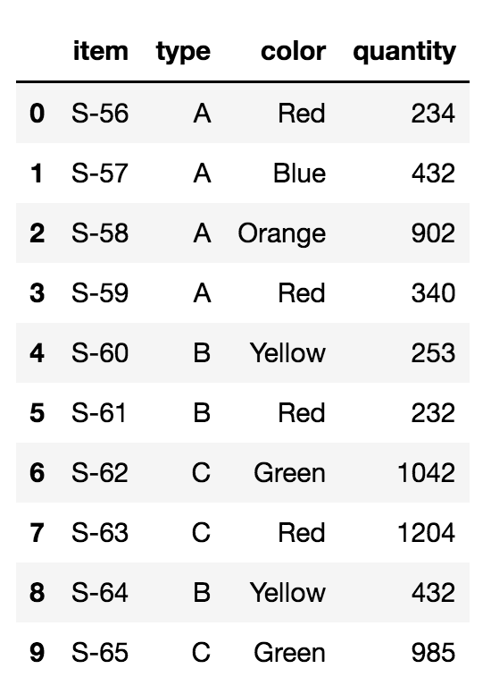
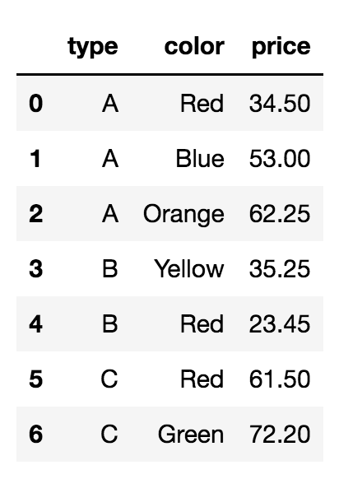
Merge
In previous examples, we merged tables using one column (one key)
We can also merge tables using multiple columns (keys)

Slide 35
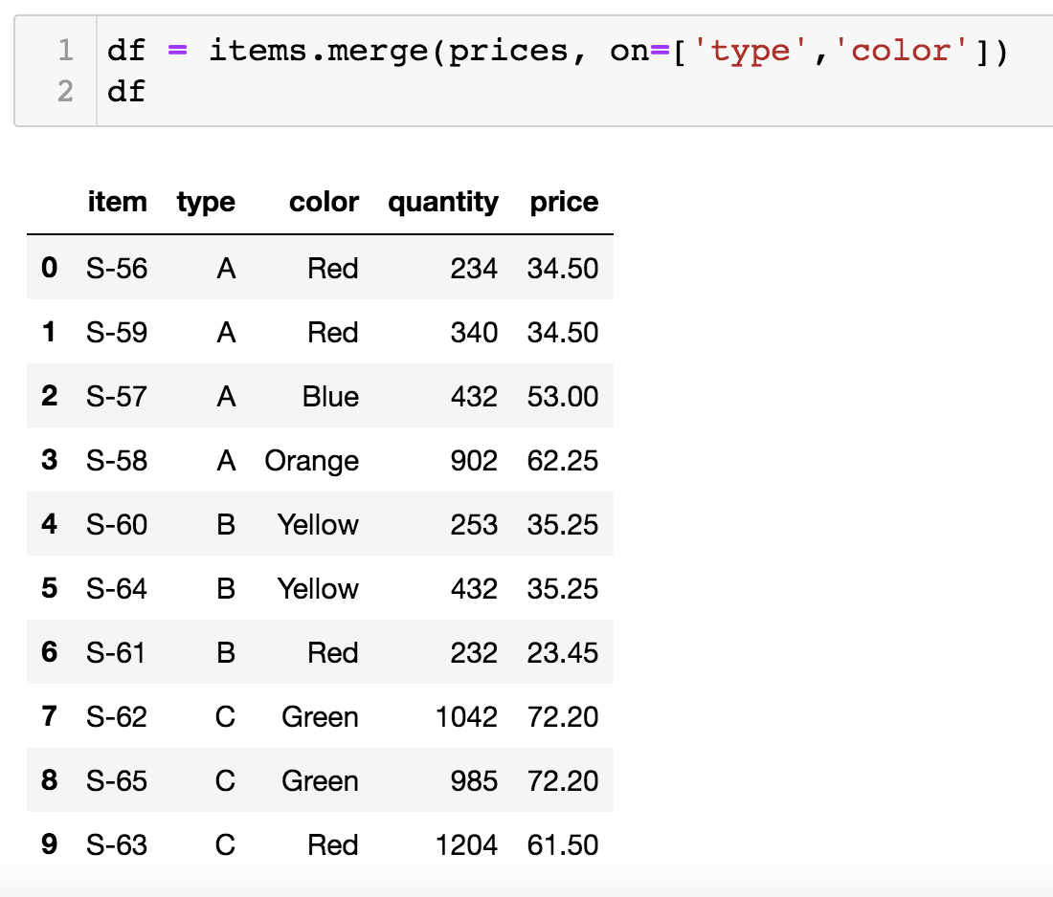
Merge

Slide 36
Merge
Exercise:
Find the total price of all items:
sum(quantity * price)

Slide 37
… Thank you …
See you next time

